Slide 1
Machine learning to predict clinical outcomes from RNS background ECoG
Byron Sun
Xiaojing Wu
Anli Liu
Notes:
The topic I am going to talk about today is…

Slide 2
Limitations of current RNS practice
Long intervals between seizures and between programming visits (2-3 months)
2. Very limited understanding of how stimulation parameters should be adjusted
Can we build a reliable classifier for an individual patient which predicts clinical outcome, based on retrospective review of that patient’s EEG?
Notes:
1) takes weeks to months to know new seizure frequency, 2) waits another 2-3 months before being informed by patient him/herself when meeting in person
Let’s first talk about some backgrounds and what’s the problem we are trying to solve here with RNS device?
RNS device is a brain-responsive neurostimulation system designed to prevent epileptic seizures at their source. The physicians who routinely examined the output from patients’ RNS device will adjust the parameter of the device according to the physician’s experience. The problem of this practice is that physicians usually need to wait a long period of time (~2-3 months) to get an idea of whether the adjustments they made to the device has improved or worsened the patient’s condition. We can see that the RNS parameter optimization is a long and slow process.
Why does physicians need to wait so long.
Although seizures are the ultimate indication of clinical outcome, a long time duration is required to reliably estimate seizure occurrence frequency during that given period of time
Also, physicians only hear about how the patient has been doing when meeting with them in person every ~3 months, it would be nice to have tools that generate more frequent quantifications of patients’ epileptic activity directly based on their EEG data

Slide 3
RNS parameter adjustment for a given patient
- How to quickly and accurately determine effectiveness?
Goal: build reliable classifier for individual patient →
generate multiple predictions per day with newly recorded “scheduled” ECoGs →
help physicians better understand the patients’ clinical conditions and make better parameter adjustment based on the prediction
Notes:
Therefore, We propose to build reliable classifier for individual patient to generate multiple predictions per day with newly recorded “scheduled” ECoGs to help physicians better understand the patients’ clinical conditions and make better parameter adjustment based on the prediction.

Slide 4
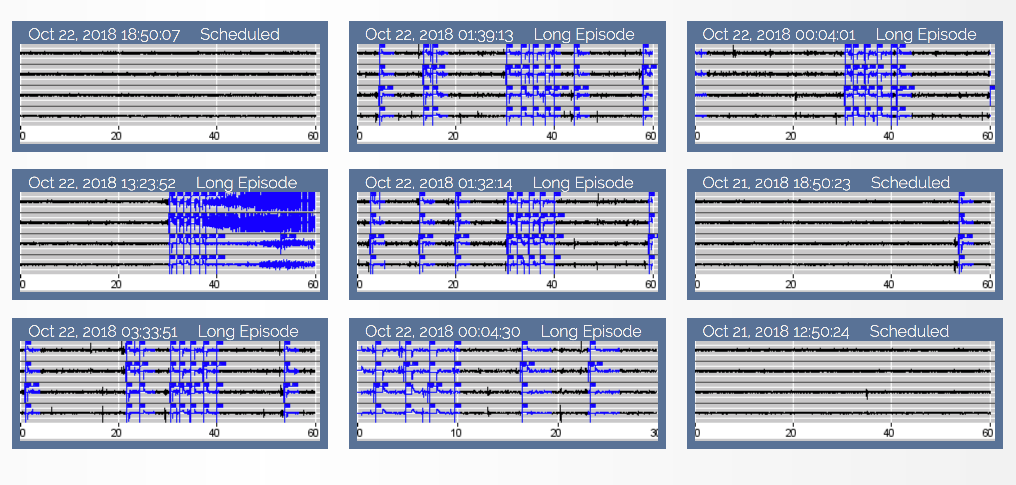
Patient 231
Representative patient, demonstrating difference in EEG characteristics between
(1) Scheduled ECoGs and (2) Long Episode Detection (Triggering Stimulation). Some LE become electroclinical seizures.
Notes:
The RNS device record scheduled eeg and eeg with long episode.

Slide 5
RNS parameter adjustment for a given patient
- How to quickly and accurately determine effectiveness?
What data should we use to predict patients’ clinical conditions?
Make use of “scheduled” ECoG segments
- Recorded multiple times per day, data abundance
- Indicative of long-term neuromodulatory effects of chronic electrical stimulation
Notes:
So, what data should we use to predict patients’ clinical conditions?
Scheduled ECoGs are directly accessible, usually multiple samples are available each day
Scheduled, i.e. background EEG pattern changes may indicate fundamental changes in the brain network
Therefore, “scheduled” ECoG segments is the ideal data we could use to build a classifier for individual patient.

Slide 6

EEG Selection Criteria
Clinical
Visit
↓
Time
No changes in RNS detection parameters
OR antiepileptic medications
1 month epochs
↙ ↓ ↘
GOOD
BAD
GOOD
BAD
BAD
GOOD
GOOD
GOOD
Find long periods of time:
- Long episodes detected by same parameters
- Any EEG pattern change cannot be caused by AED changes
GOOD: relatively low average daily long-episode count
BAD: relatively high average daily long-episode count
Notes:
Let me illustrate our methods using images. The black house represents clinical visits. And we can see there are 5 clinical visits here. In, each clinical visits, physicians may change RNS detection parameters
OR antiepileptic medications. Of course, the RNS device parameter may also be changed. Among all the time we have seen in the image, we will be using the time where there is No changes in RNS detection parameters
OR antiepileptic medications. In other words, we will find long periods of time:
- when Long episodes are detected by same parameters
- and Any EEG pattern change cannot be caused by AED changes
Furthermore, the time we choose can be divided into several 1 month epochs. Each epoch has a label, good or bad. We will be using long episode count as a biomarker for clinical condition in epilepsy treatment. Good means patient’s clinical condition is relatively good, that is there are relatively low average daily long-episode count for that patient. Vice versa

Slide 7
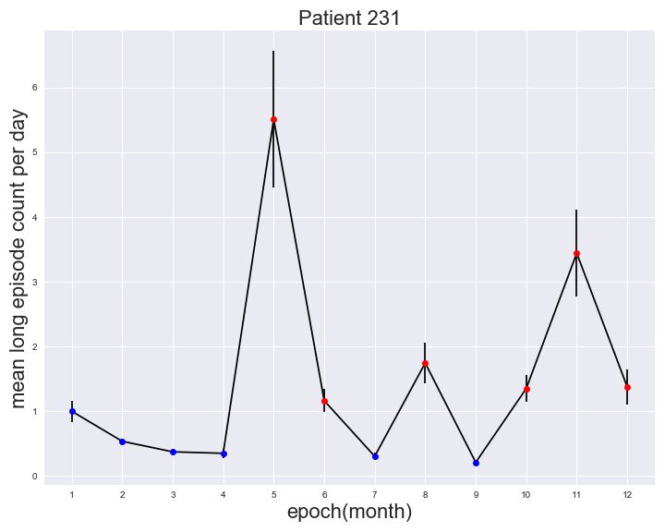
Methods
Average long-episode number per day, over one-month epochs
Notes:
This is an example of the actual data,
1. Maker bigger
12 month clean period
thresholded by median
across the moth
half of the total epochs with higher LE count are bad, the other lower half are good

Slide 8
Methods
Feature calculation
EEG
segment
…
Channel 1
Delta
Channel 2
Delta
Channel 3
Delta
Channel 4
Delta
Channel 1
Theta
Channel 2
Theta
Channel 3
Theta
Channel 4
Theta
(band power)
Classic frequency bands:
Delta = 0.5 - 4 Hz
Theta = 4 - 8 Hz
Alpha = 8 - 12 Hz
Beta = 12 - 25 Hz
Low gamma = 25 - 50 Hz
High gamma = 50 - 124.9 Hz
Entire band = 0.01 - 124.9 Hz
4 channels X 7 frequency bands
= 28 features per EEG segment
Notes:
Remember we try to predict clinical condition, that is the labels mentioned in the last slide based the backgrounds EEG segments recorded. However, we cannot directly use EEG segment in the traditional machine learning model because of the high dimension and high variance nature of the EEG segments. Instead, we use features extracted from EEG segments to build the machine learning model and predict the label based on the features. So each EEG segment can produce ……

Slide 9
Methods
BAD
Features
EEG
segment
Features
Features
Features
Machine
Learning
Features
EEG
segment
Features
Features
Features
GOOD
Notes:
That is an illustration of our model. We first ….
collect all scheduled EEG from all GOOD epochs --> one class
........................................................BAD epochs --> second class

Slide 10
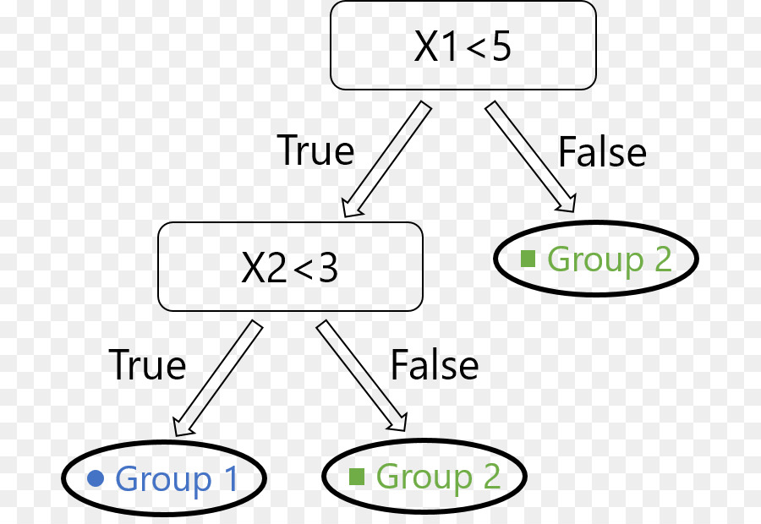
Methods
Machine learning methods
Decision tree

Slide 11
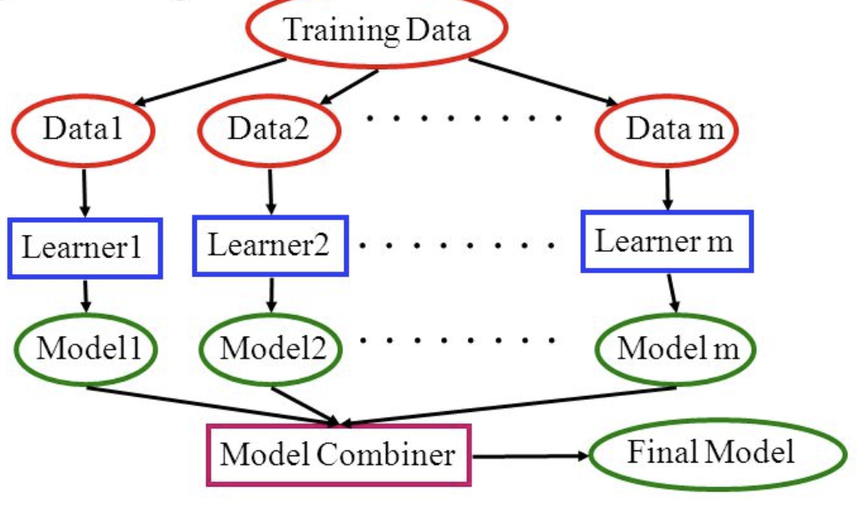
Methods
Machine learning methods
Ensemble Model: Random Forest, Gradient Boosting
Notes:
To begin with, ensembling technique means that prediction is done by an ensemble of simpler estimators
The aim of gradient boosting is to create (or "train") an ensemble of trees, given that we know how to train a single decision tree. This technique is called boosting because we expect an ensemble to work much better than a single estimator.
The intuition is they're all right more often than they're wrong, and different learners tend to be wrong on different examples so when they all vote you often get the right answer.
You can explain why it works using the bias and variance decomposition. In the case of an ensemble of randomized models (e.g., bagging, random forests, etc), randomizing has the effect of increasing the bias of the ensemble slightly, but then often makes it possible the reduce its variance to a larger extent, hence the better overall performance.

Slide 12
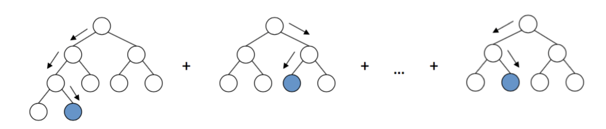
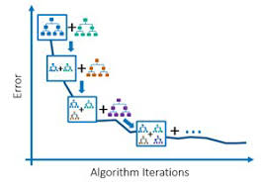
Methods
Machine learning methods
Gradient Boosting
Notes:
Here comes the most interesting part. Gradient boosting builds an ensemble of trees one-by-one, then the predictions of the individual trees are summed:
The next decision tree tries to cover the discrepancy between the target function f(\mathbf{x})f(x) and the current ensemble prediction by reconstructing the residual.

Slide 13
Patient Selection Criteria
Methods
Good RNS upload compliance
Have scheduled ECoGs multiple times per day
Have a relatively clean EEG background
Good clinical correlation between long episodes and clinical seizures
Infrequent medication changes
Past the 6 month window of implant effect, and past the detection adjustment stage.

Slide 14
Analyzed patients
Patient ID | Patient Initials | Gender | Age | Clean periods (Days) | Leads location
NY231 | DB | F | 33 | 379 | L hippocampal depth R hippocampal depth
NY222 | AJ | M | 25 | 255, 215 | L insular depth L superior temporal strip
NY229 | TR | M | 26 | 318 | Insular depth L mid-central strip
Notes:
we've identified one long clean period for ...

Slide 15
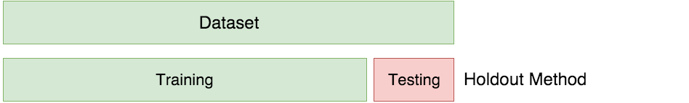
Methods
Training & Testing
80%
20%
Notes:
20% test
1. Remove everything cross validation; move this part to end as supplemental slide

Slide 16
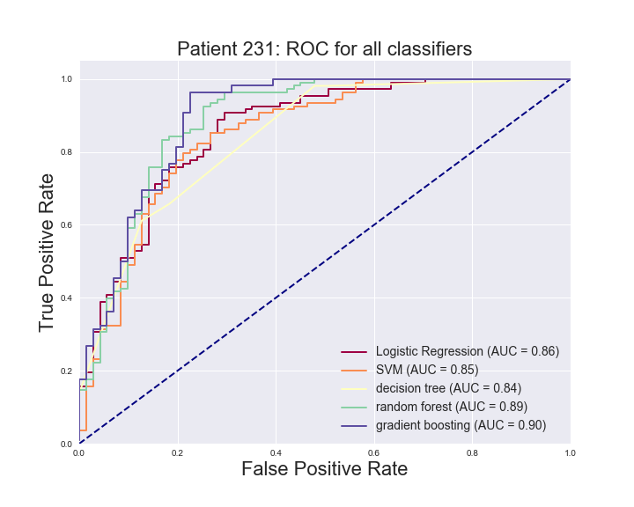
Results
Best classifier for 231 is gradient boosting with AUC = 0.90, accuracy = 87.15%

Slide 17
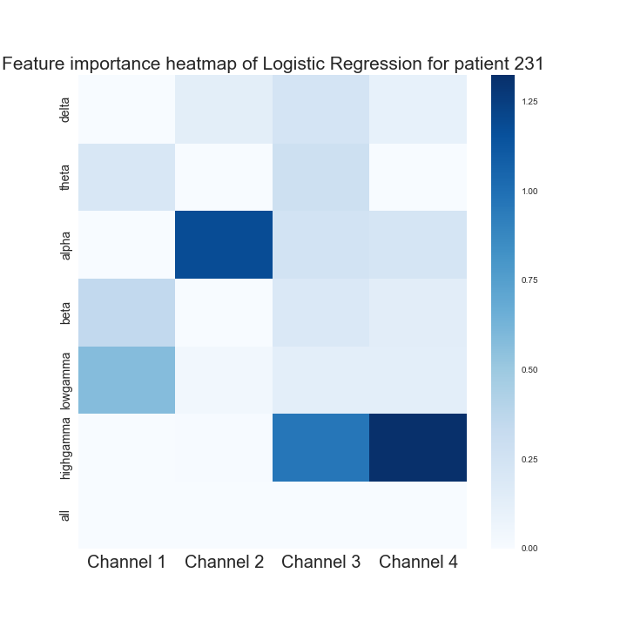
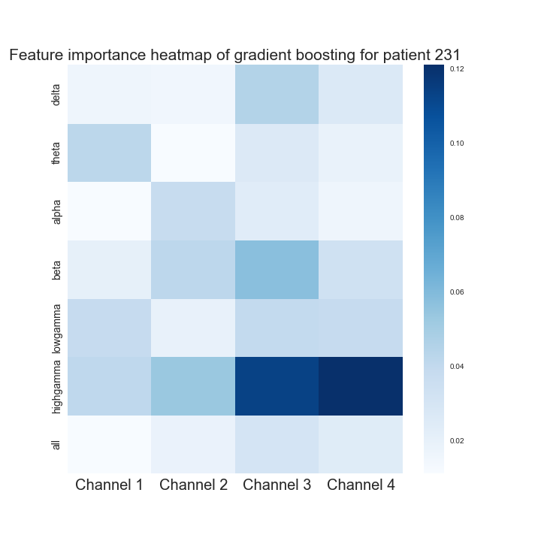
Results
Logistic Regression
Gradient boosting
Important features:
high gamma Channel 4
alpha Channel 2
high gamma Channel 3
Important features:
high gamma Channel 4
high gamma Channel 3
beta Channel 3
Notes:
Xlable:channel 1, channel 2, …
Put gradient boosting in this same slide

Slide 18
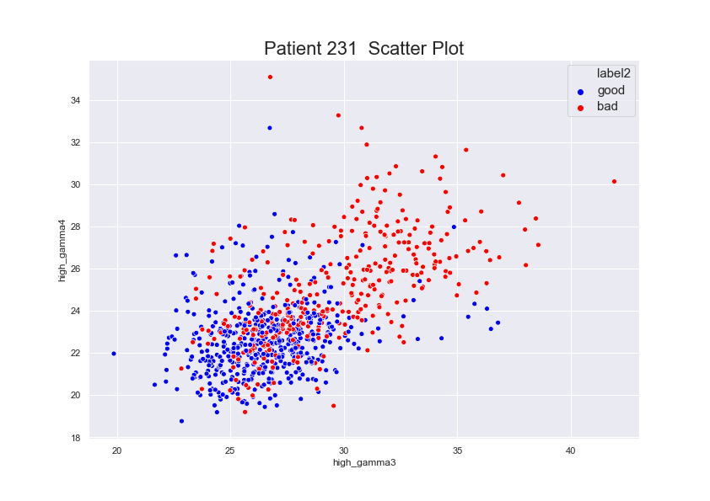
Results
Notes:
Xlable:channel 1, channel 2, …
Put gradient boosting in this same slide

Slide 19
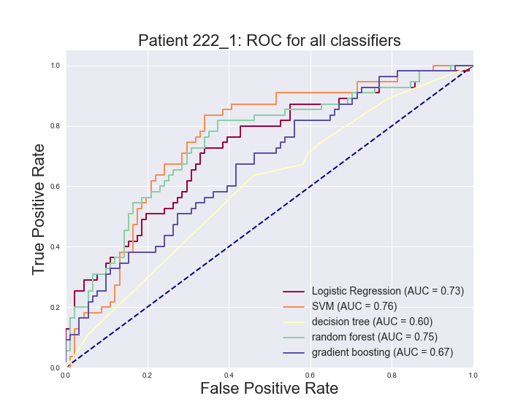
Results
Best classifier for 222_1 is SVM with AUC = 0.76, accuracy = 71.92%

Slide 20
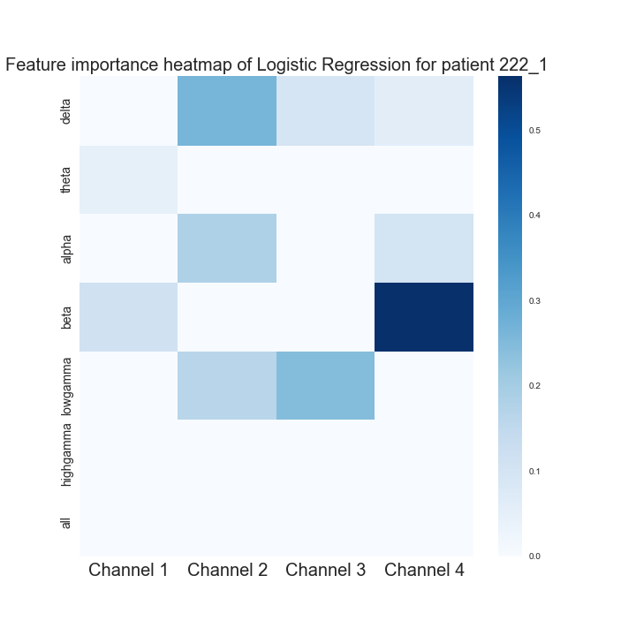
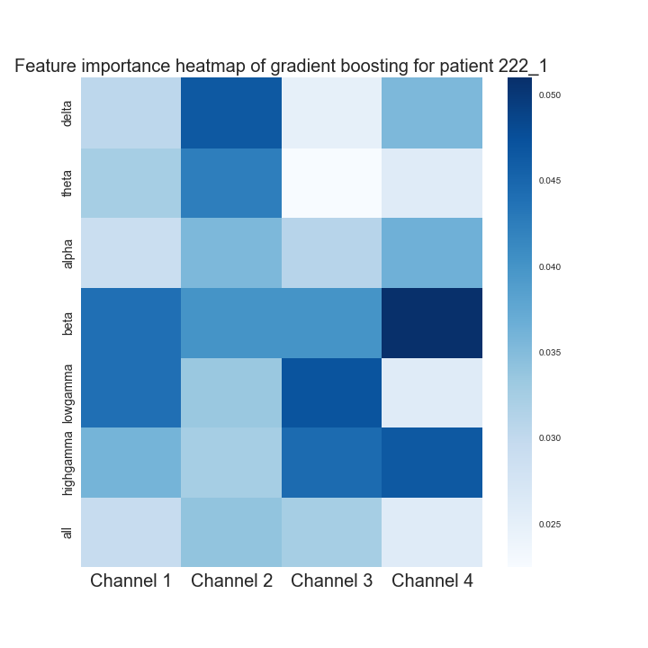
Results
Logistic Regression
Gradient boosting
Important features:
beta Channel 4
low gamma Channel 3
delta Channel 2
Important features:
beta Channel 4
low gamma Channel 3
delta Channel 2
Notes:
Xlable:channel 1, channel 2, …
Put gradient boosting in this same slide

Slide 21
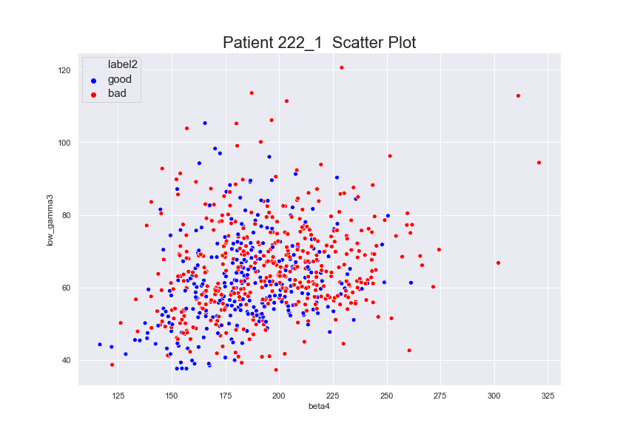
Results
Notes:
Xlable:channel 1, channel 2, …
Put gradient boosting in this same slide

Slide 22
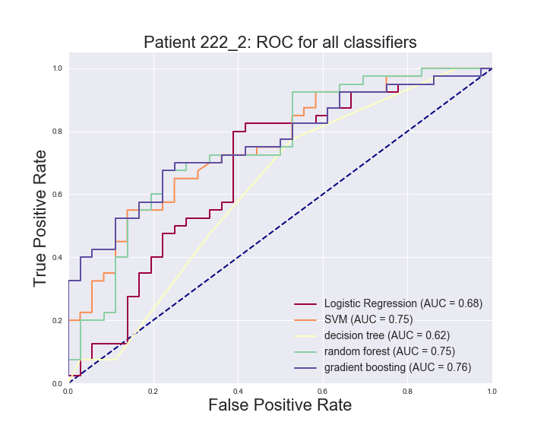
Results
Best classifier for 222_2 is gradient boosting with AUC = 0.76 , accuracy = 72.37%

Slide 23
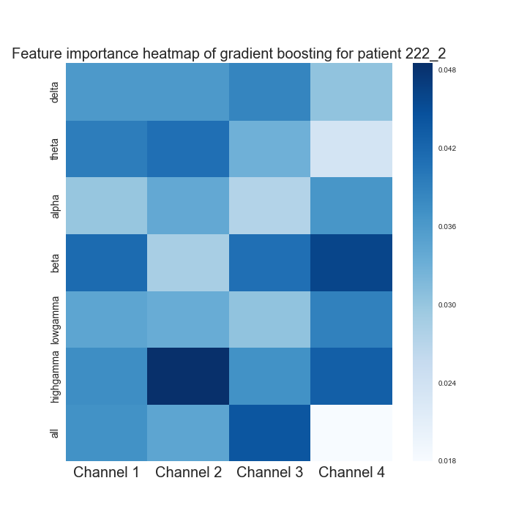
Results
Gradient boosting
Important features:
high gamma Channel 2
beta Channel 4
all Channel 3
Notes:
Xlable:channel 1, channel 2, …
Put gradient boosting in this same slide

Slide 24
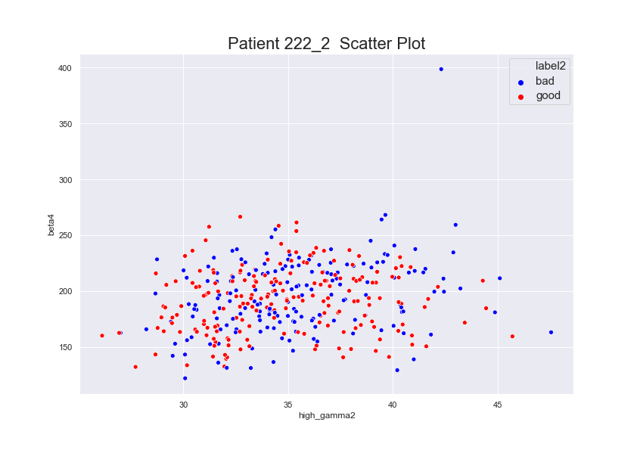
Results
Notes:
Xlable:channel 1, channel 2, …
Put gradient boosting in this same slide

Slide 25
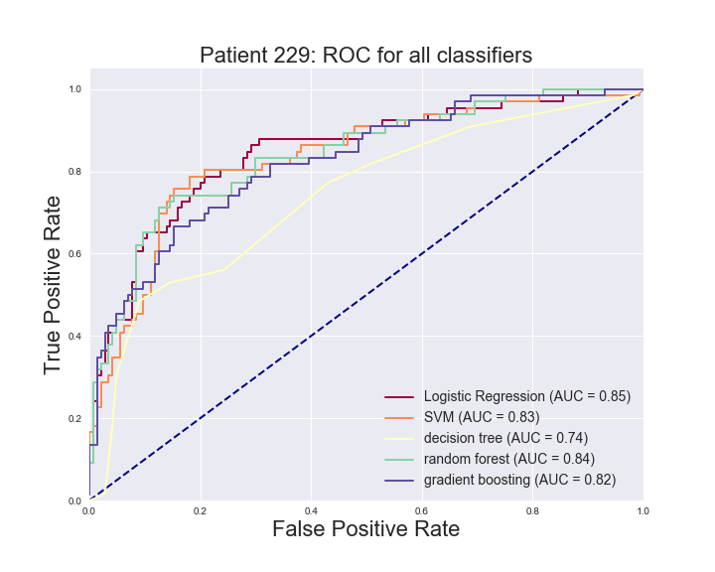
Results
Best classifier for 229 is Logistic Regression with AUC = 0.85 , accuracy = 81.43%

Slide 26
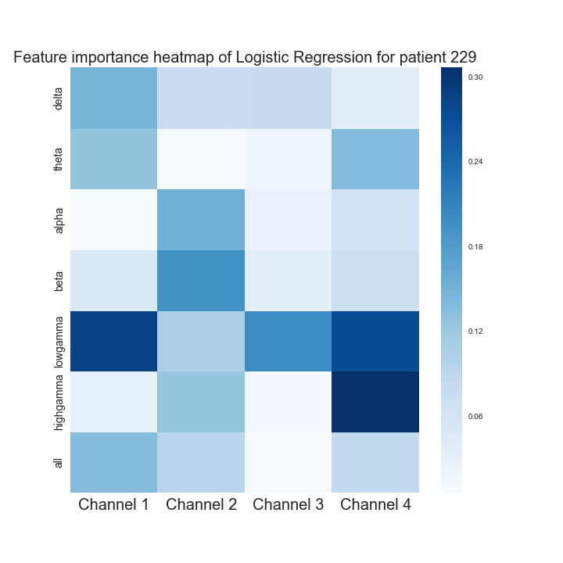
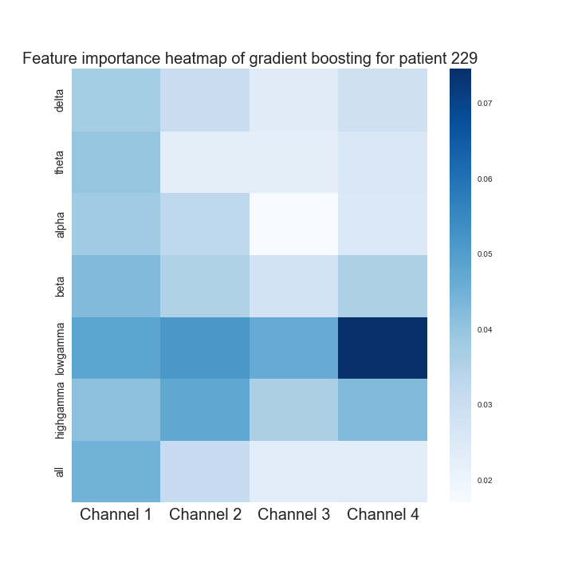
Results
Logistic Regression
Gradient boosting
Important features:
high gamma Channel 4
low gamma Channel 1
low gamma Channel 4
Important features:
low gamma Channel 4
low gamma Channel 2
low gamma Channel 1
Notes:
Xlable:channel 1, channel 2, …
Put gradient boosting in this same slide

Slide 27
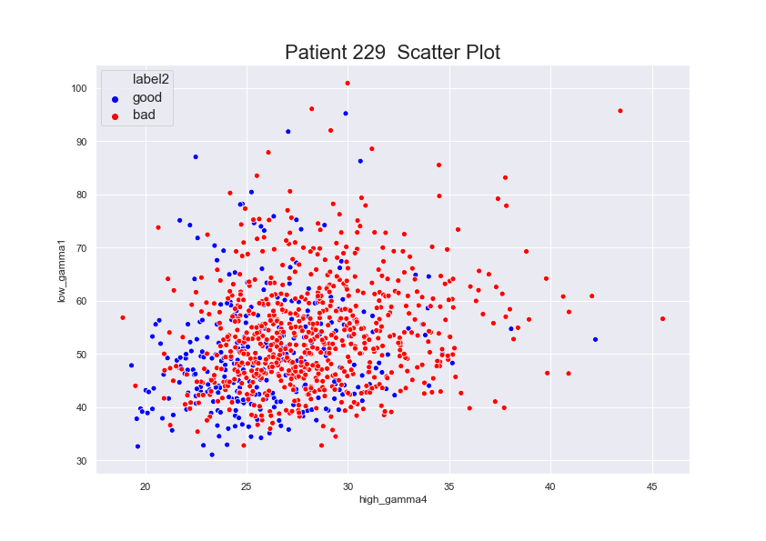
Results
Notes:
Xlable:channel 1, channel 2, …
Put gradient boosting in this same slide

Slide 28
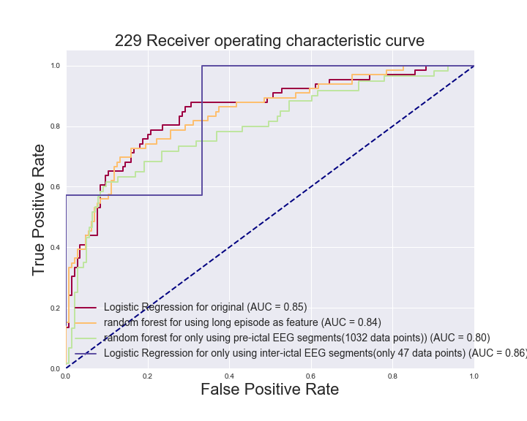
Results – discussion 1
Discover the role of pre-ictal EEG segments in predicting clinical conditions
Notes:
To overcome the problem of data insuffiency for this patient, we also included long-episode EEG segments
pre-ictal EEG is the first several seconds before the first stimulation of Long Episode EEG segments

Slide 29
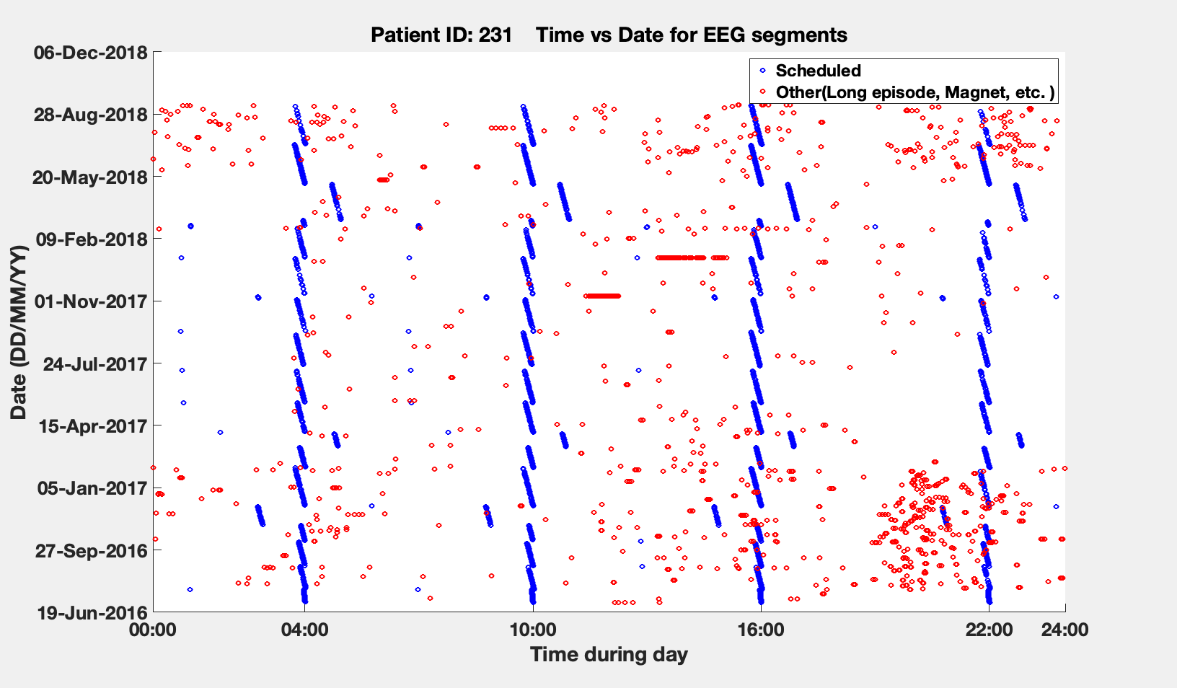
Results – discussion 2
Discover the role of sleep in predicting clinical conditions
Notes:
Time vs date

Slide 30
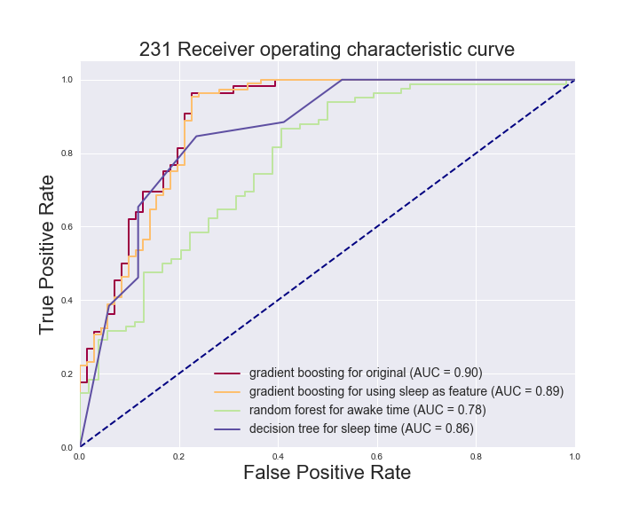
Results – discussion 2
Discover the role of sleep in predicting clinical conditions

Slide 31
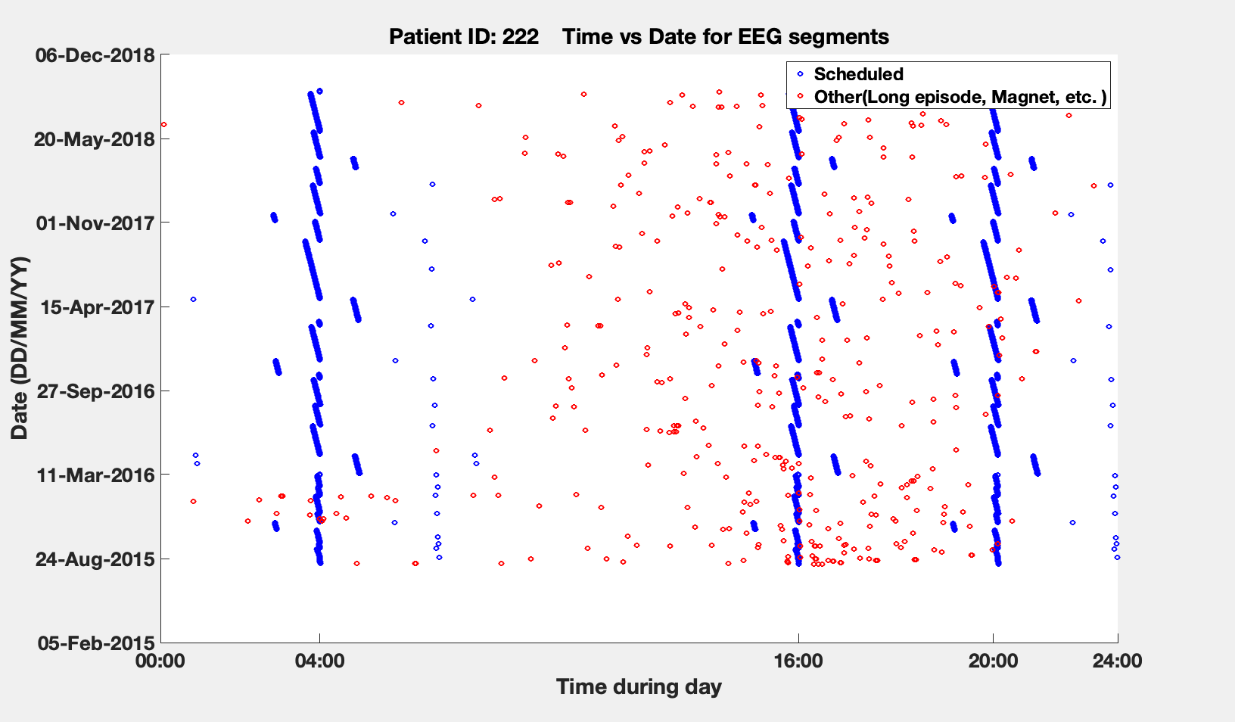
Results – discussion 2
Discover the role of sleep in predicting clinical conditions
Notes:
Time vs date

Slide 32
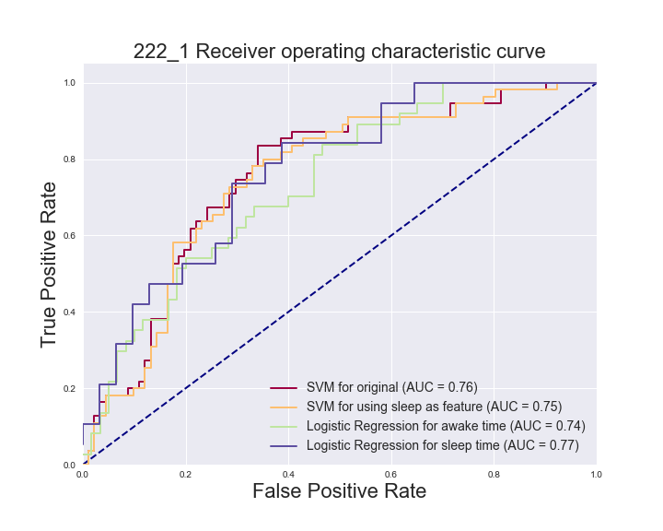
Results – discussion 2
Discover the role of sleep in predicting clinical conditions

Slide 33
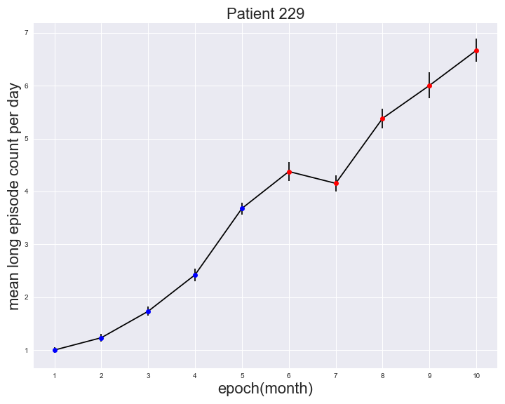
Results – discussion 3
Average long-episode number per day, over one-month epochs

Slide 34
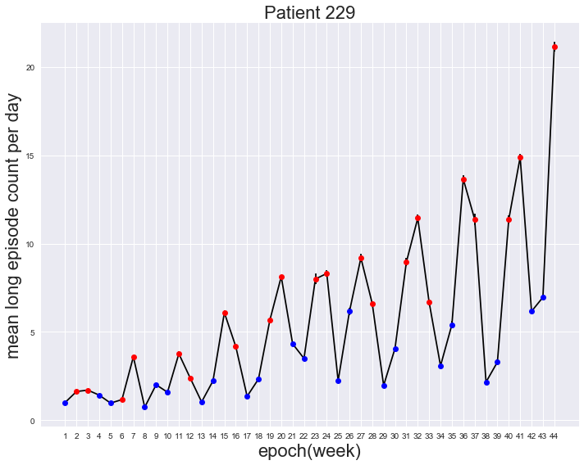
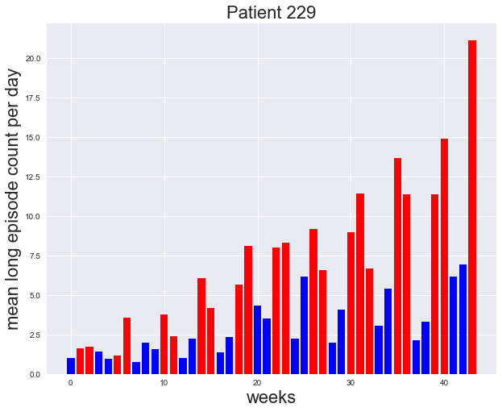
Results – discussion 3
Average long-episode number per day, over one-week epochs

Slide 35
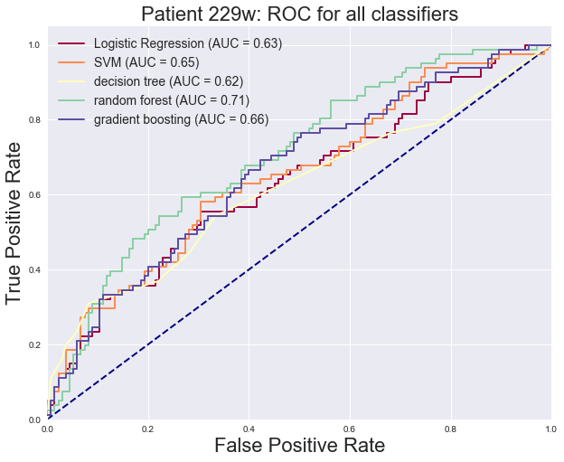
229 monthly ROC plot
Results – discussion 3
229 weekly ROC plot

Slide 36
Summary and Discussion
Background ECoG can be used to predict clinical outcomes for an individual patient.
The implication of best classifier. Gradient boosting and Random forest combine the prediction of large number of weak classifiers to achieve better results than using single classifier and prevent overfitting problem.
Feature importance analysis implicates greater contributions from higher frequency bands.
Sleep ECoG achieve better classification performance when compared to awake ECoG. The reason may be that sleep EcoG shares stronger correlations with ictal activity.
Background EEG appears to be equally valuable as pre-ictal EEG in predicting clinical outcome.

Slide 37
Future steps
Train the classifier on more patients to see if the machine learning method can
generalize to more clinical cases
Incorporate multidien rhythm information directly in classifier to improve performance

Slide 38
Appendix

Slide 39
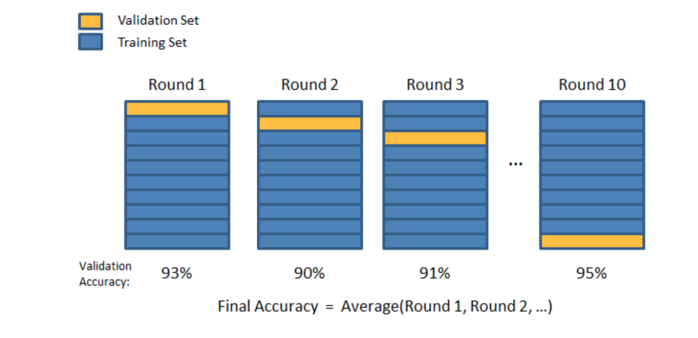
Experiments
Training, Testing and Cross-validation

